Slide 1


END-TO-END AZURE DATA ENGINEERING SOLUTION
BY
DIANA AVWENAGHAGHA
2024

Slide 2




PROCESS
▶ DATA ARCHITECTURE
▶ UPLOAD FILE TO SQL SERVER
▶ PROVISION AZURE DATA FACTORY,AZURE DATABRICKS AND AZURE DATA LAKE STORAGE
▶ CREATE LINKED SERVICE IN AZURE DATA FACTORY TO MOVE DATA FROM
SQL SERVER TO AZURE DATA LAKE STORAGE
▶ CONNECT AZURE DATABRICKS TO STORAGE-PYSPARK
▶ PROCESS DATA IN DATABRICKS(CLEAN DATA AND CREATE NEW TABLES)
▶ CREATE DASHBOARD IN POWER BI

Slide 3
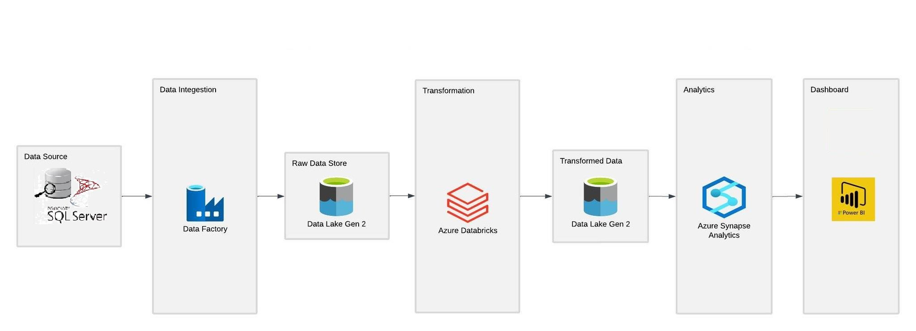
SUPER STORE ORDERS END-TO-END AZURE DATA ENGINEERING PROJECT

Slide 4
DATA ENGINEERING TOOLS
▶ SQL SERVER-ON PREM DATA STORAGE
▶ AZURE DATA FACTORY – DATA INGESTION
▶ BLOB STORAGE(ADLS GEN2) – DATA STORAGE
▶ AZURE DATABRICKS – DATA PROCESSING
▶ PYSPARK
▶ SPARK SQL
▶ POWER BI – ANALYSIS AND DASH BOARDING

Slide 5
BUSINESS REQUIREMENTS (KPIs)
▶ TOTAL QUANTITY, TOTAL SALES ,TOTAL PROFIT
▶ SALES BY PRODUCT CATEGORY
▶ SALES BY CITY
▶ SALES BY STATE
▶ TOP 5 PURCHASING CUSTOMERS PER YEAR
▶ AVERAGE SALES PER MONTH

Slide 6
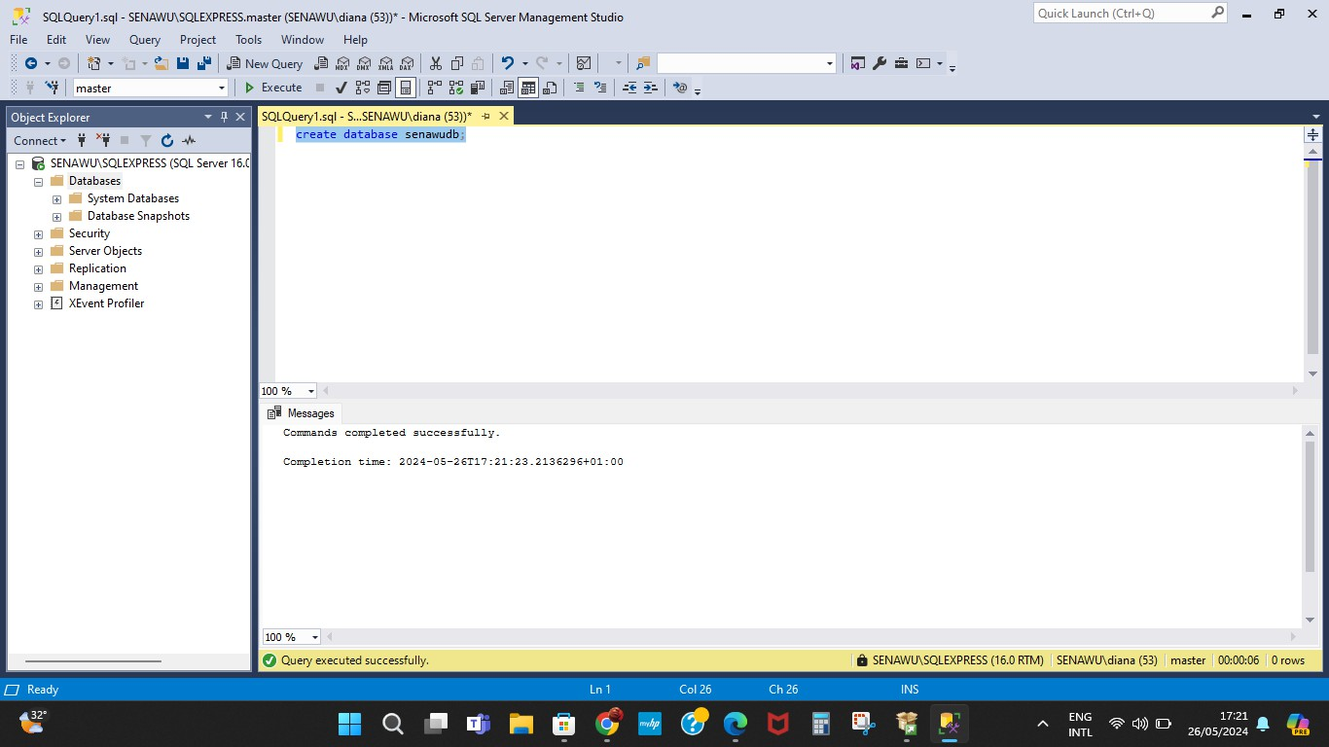
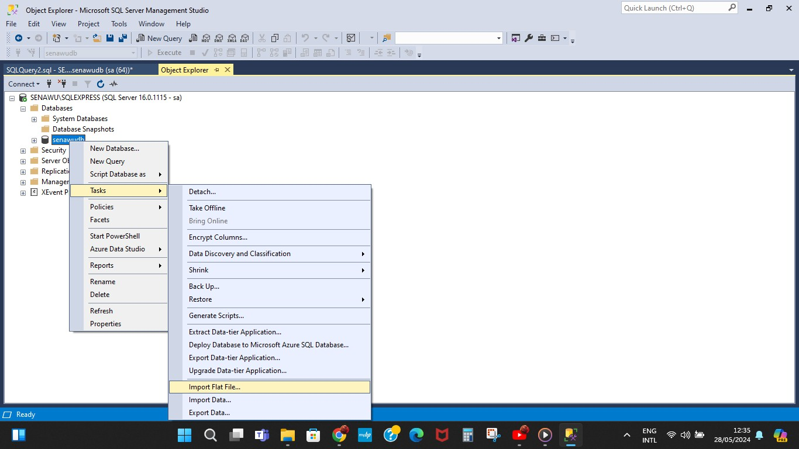
SQL SERVER UPLOADING FILE TO SQL SERVER
Migration start point, migrates data to the Azure portal. A primary data source where the raw data resides
Data base created on SQL on prem server caring out its task by importing the flat file

Slide 7
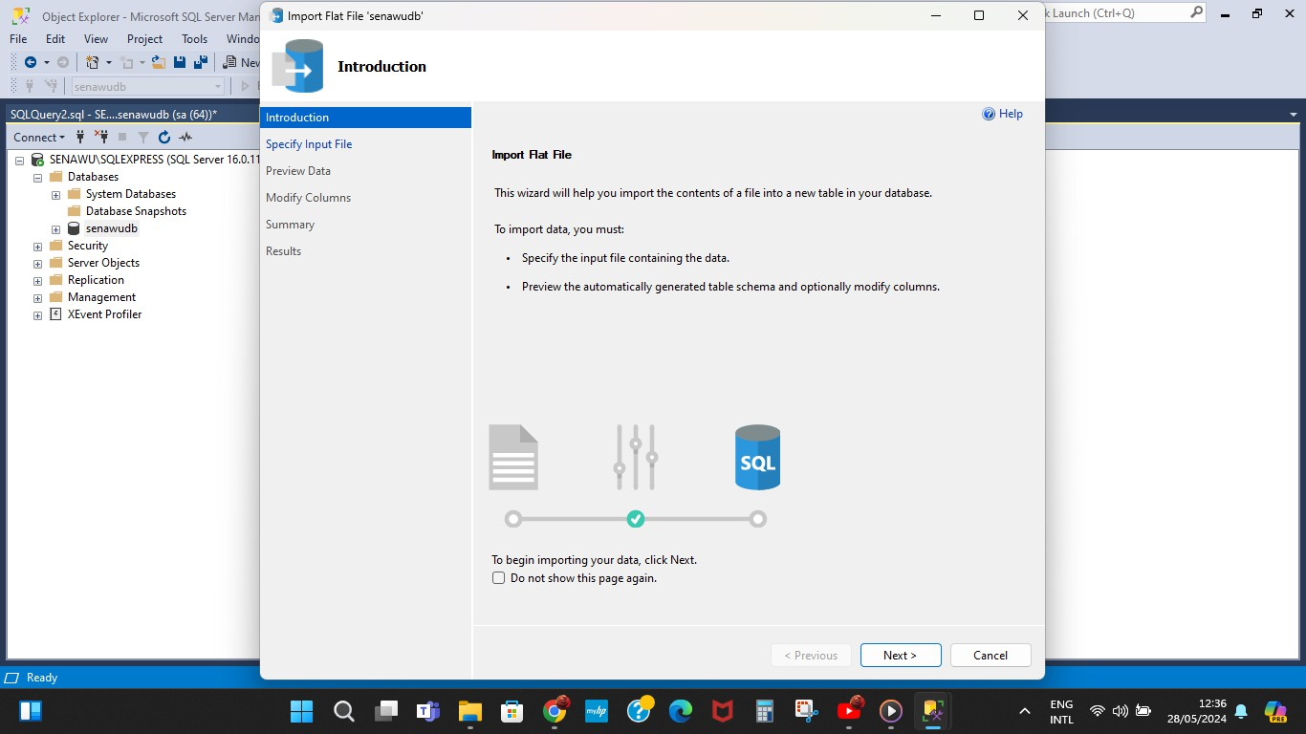
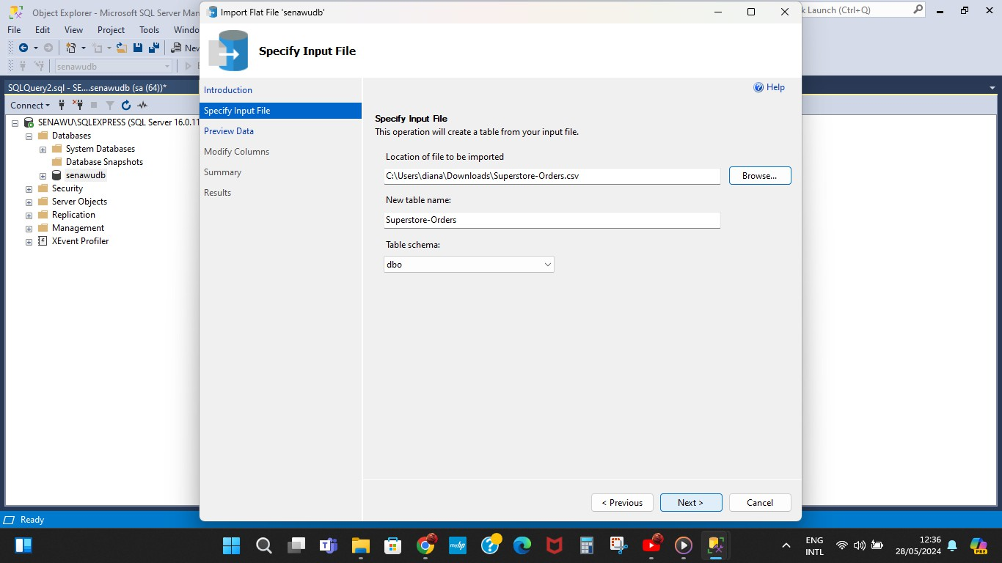
IMPORTATION OF FLAT FILE PROGRESSING

Slide 8
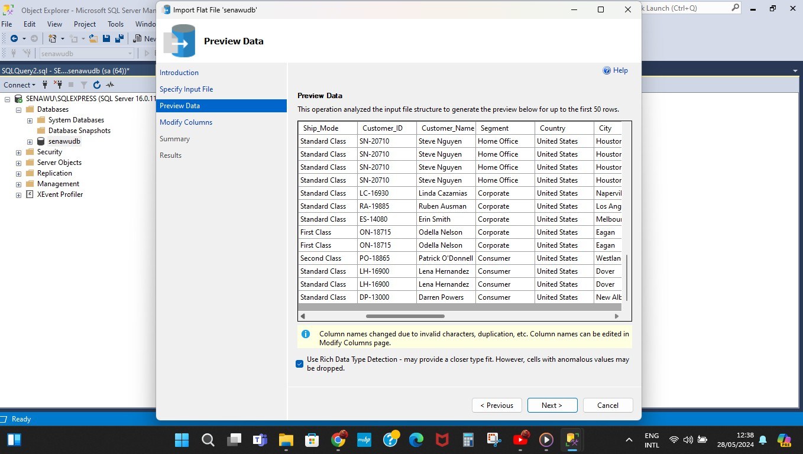
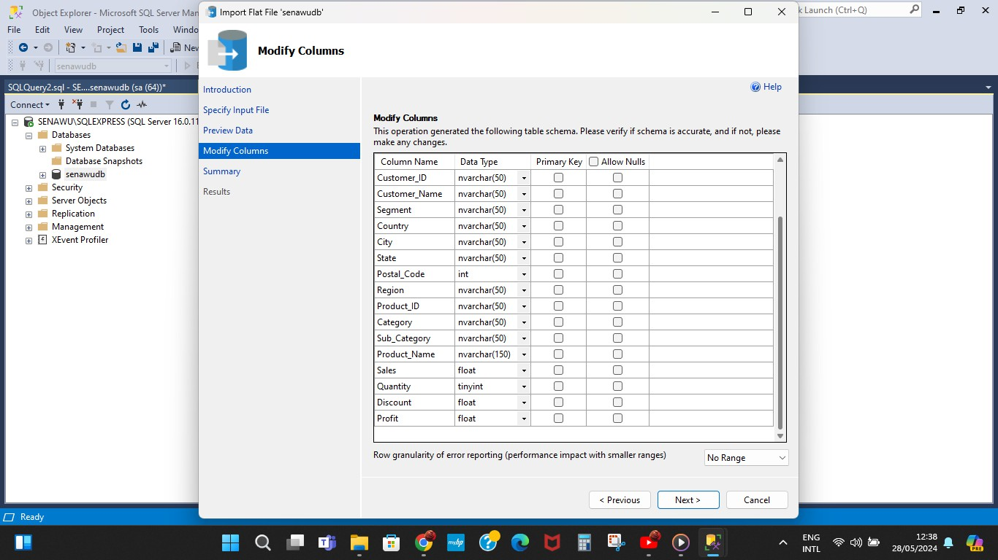
MODIFY COLUMNS

Slide 9
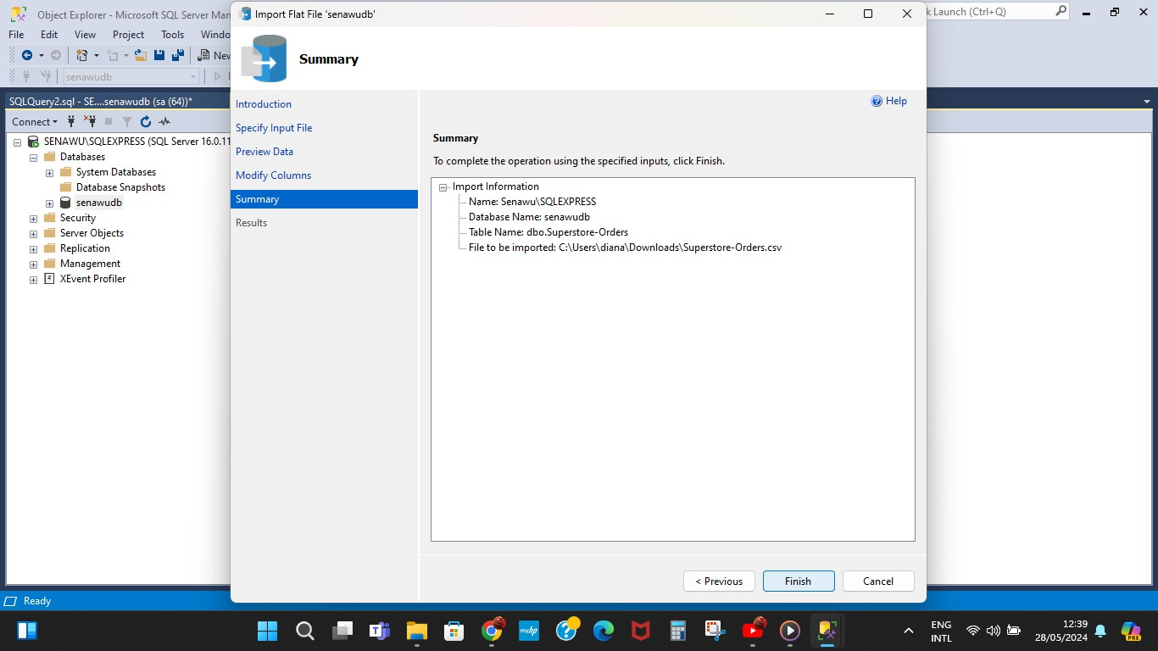
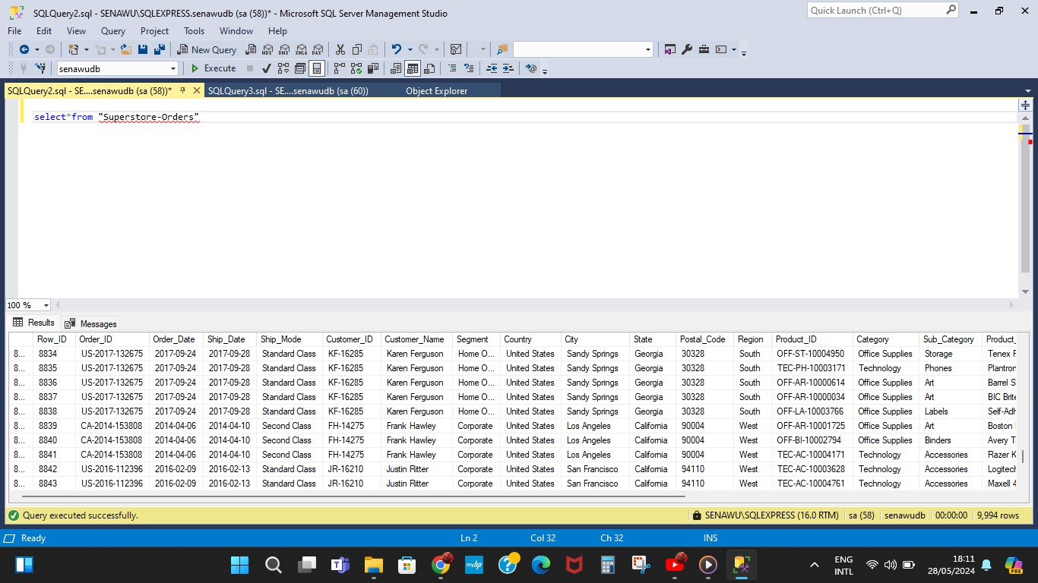
File importation finalized
Query ran to view file imported

Slide 10
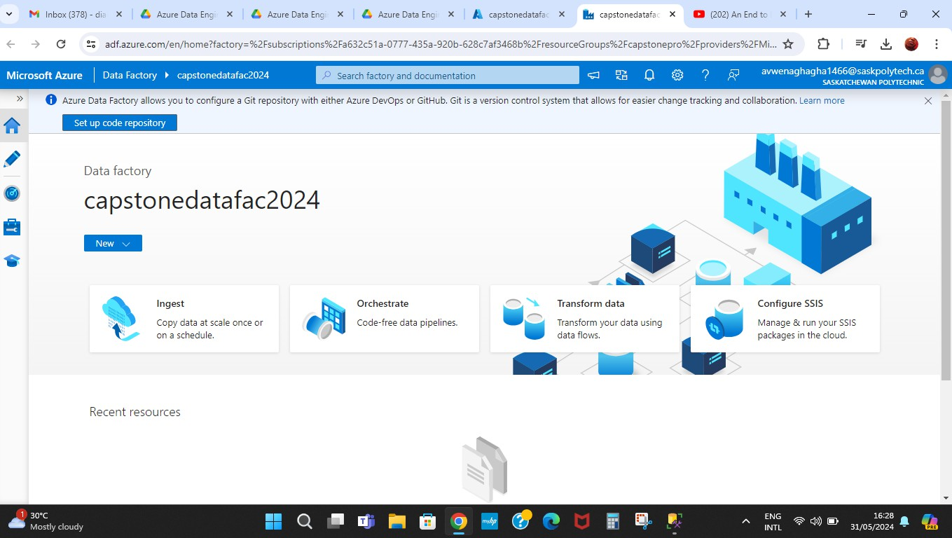
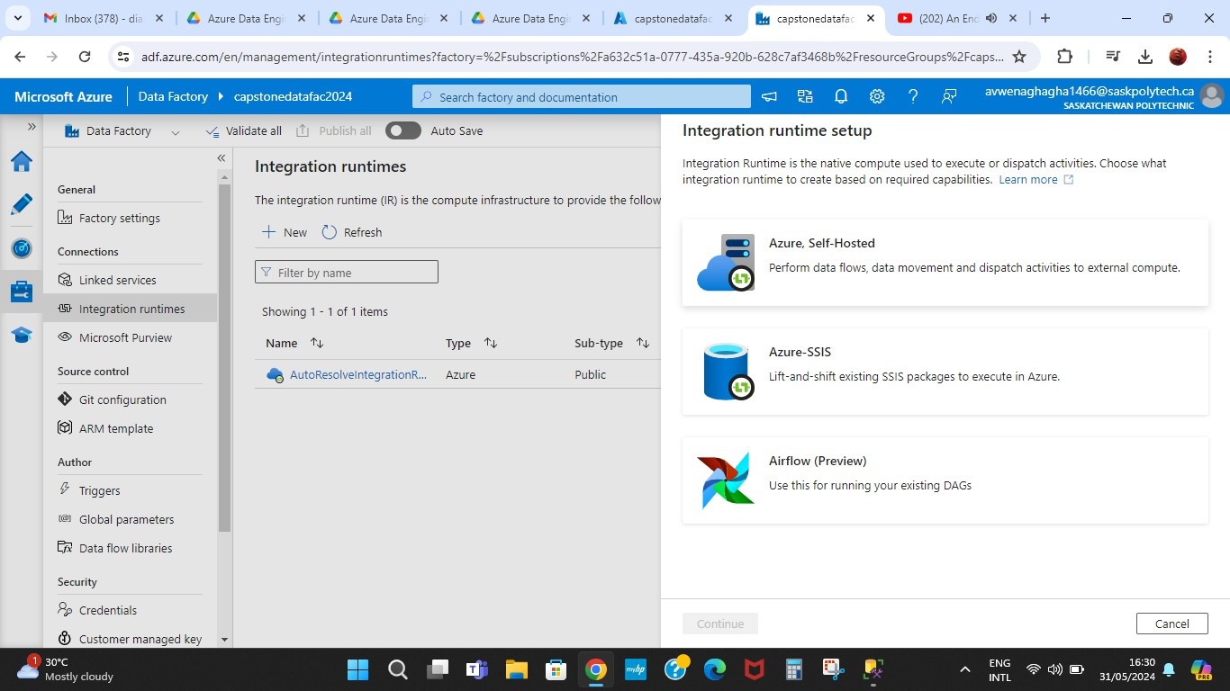
DATA INGESTION
Azure data factory is a tool for extraction of data from on prem server. A process known as data ingestion . Pipelines are set up caring out ingestion along side other resources.
Data is extracted from SQL Server using Azure Data Factory, enabling the integration of on- premises data with cloud services.

Slide 11
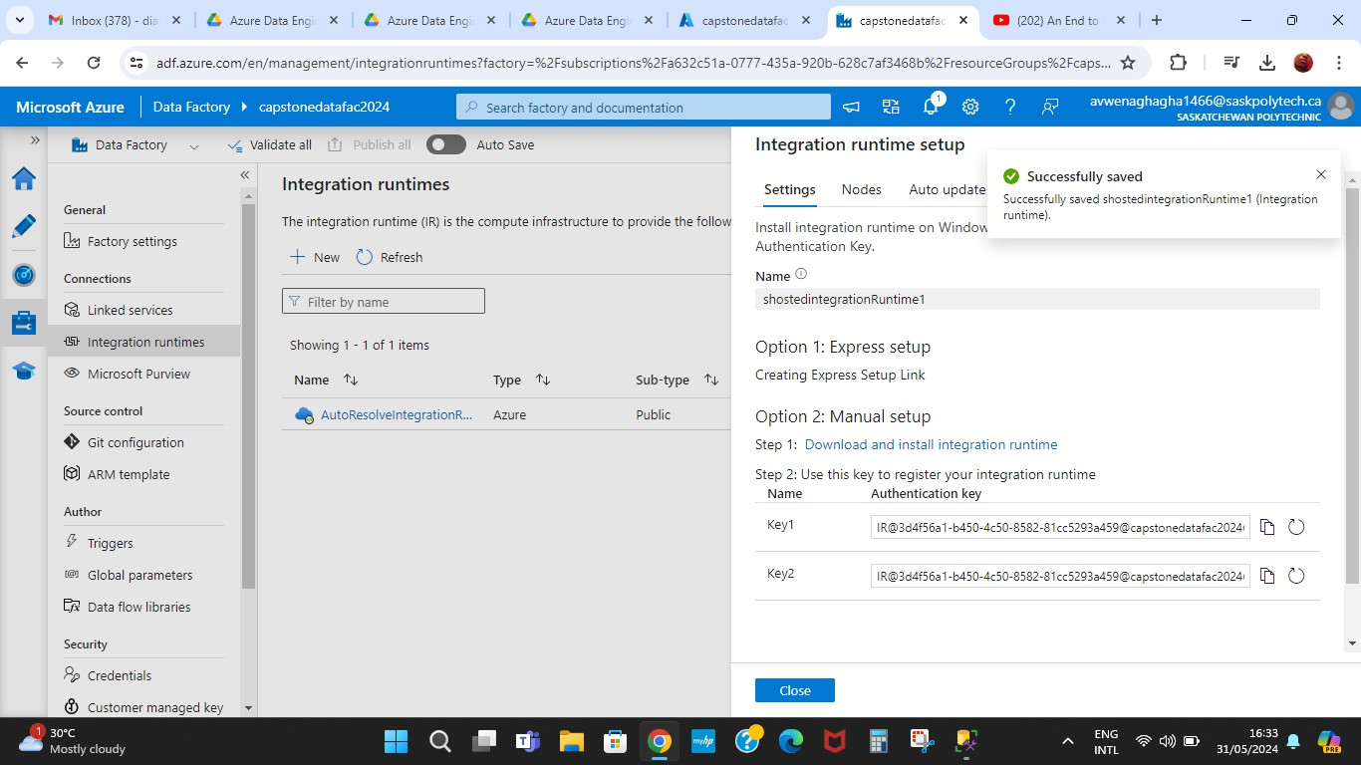
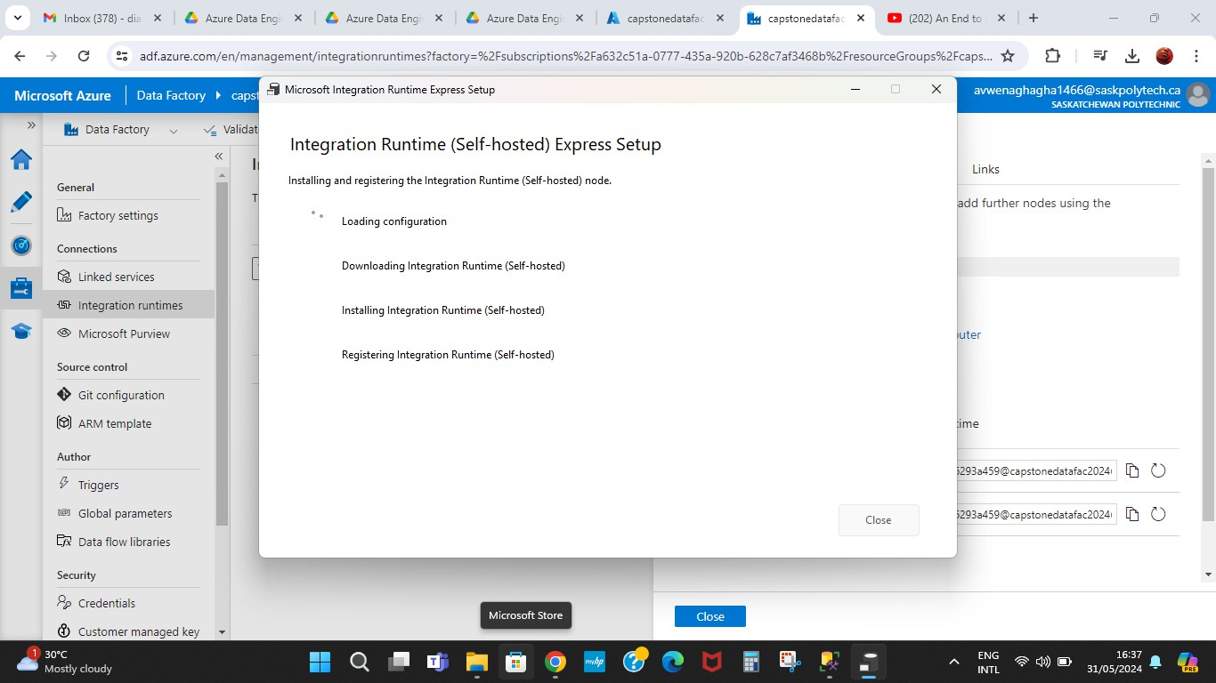
SELF –HOSTED INTEGRATION RUNTIME
Self-hosted integration runtime installation on Azure data factory
Self-hosted integration runtime is installed on a local or virtual machine and supports various data sources including SQL server and oracle

Slide 12
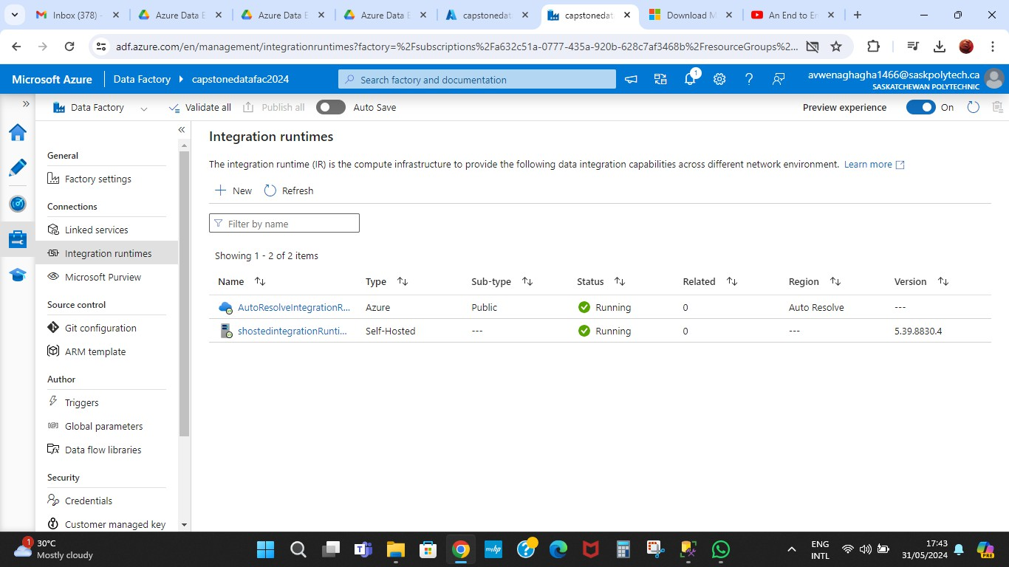
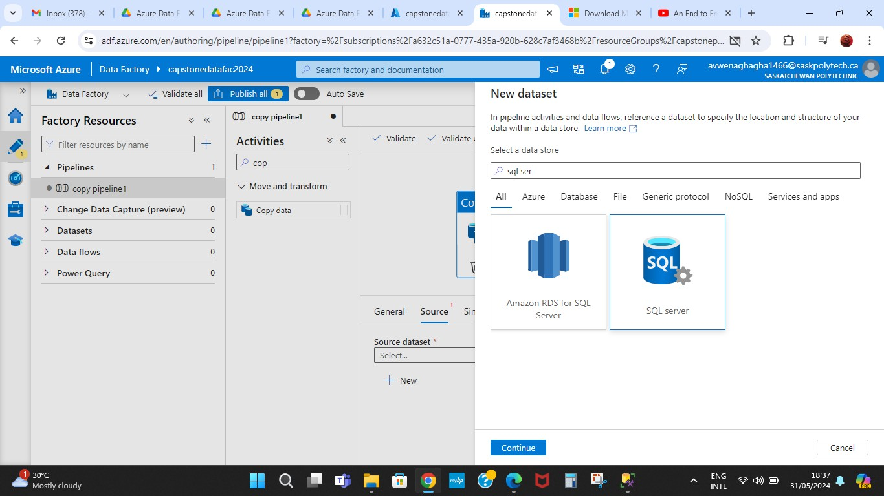
Self-hosted integration runtime
successfully installed and running

Slide 13
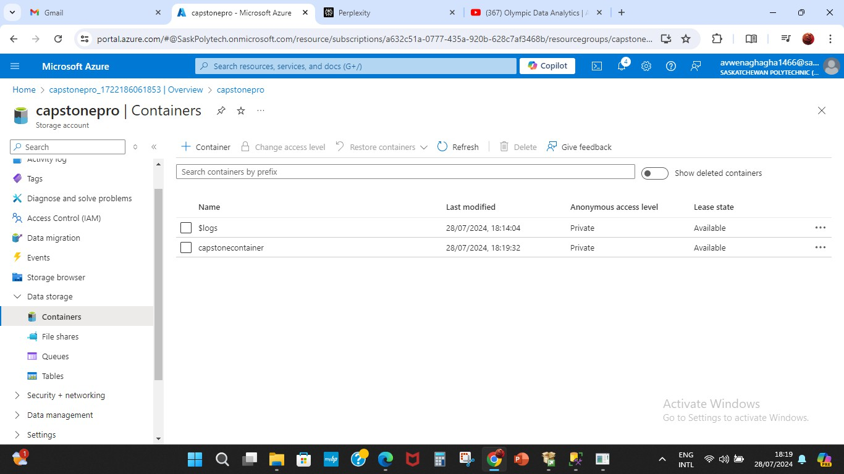
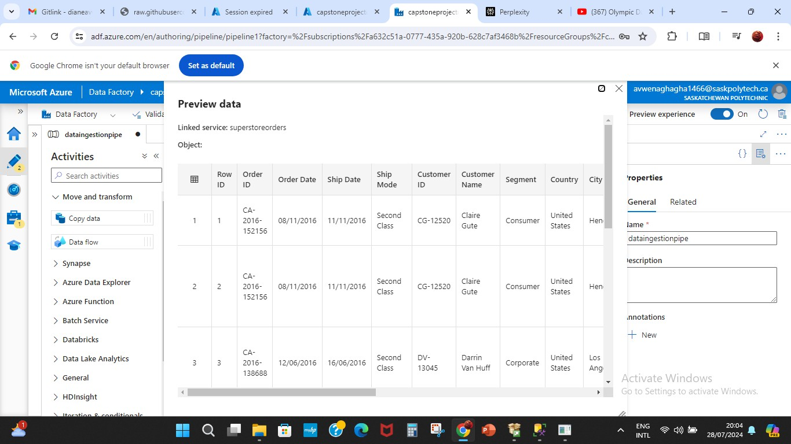
AZURE DATA LAKE GEN 2
Azure Data Lake Gen 2 acts as a scalable and secure storage solution for large volumes of data. It stores both raw and processed data in a hierarchical file system, allowing for efficient data management
The raw data ingested from SQL Server is stored in Data Lake Gen 2, serving as a staging area for further processing and transformation.

Slide 14
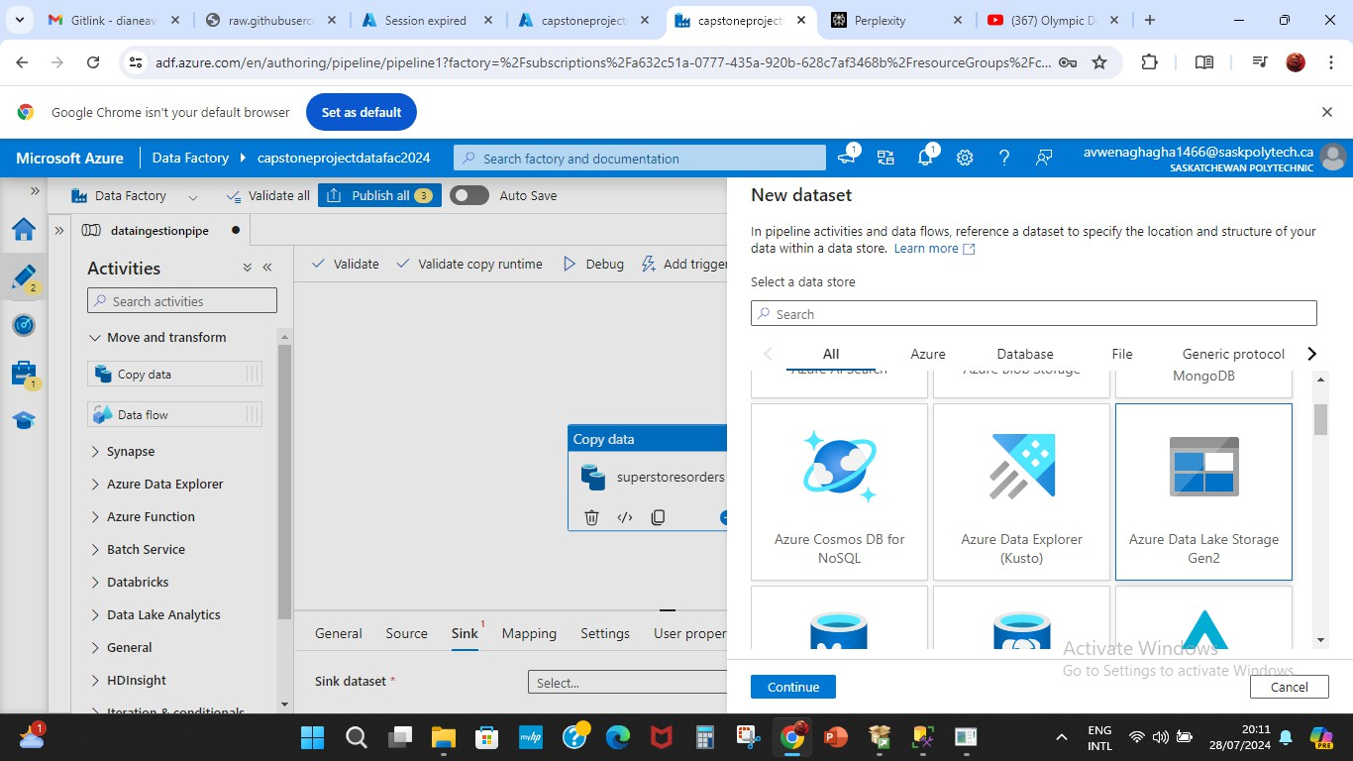
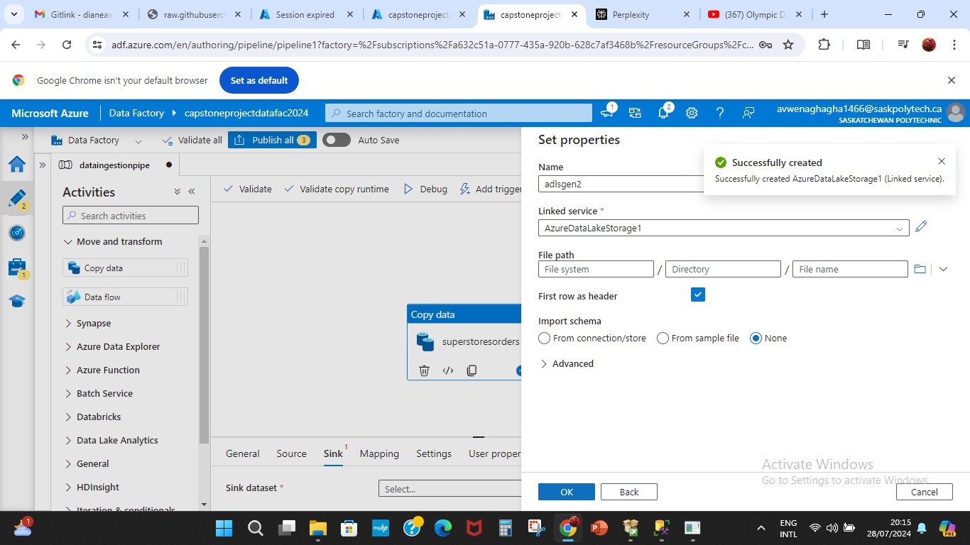
Pipelines creation

Slide 15
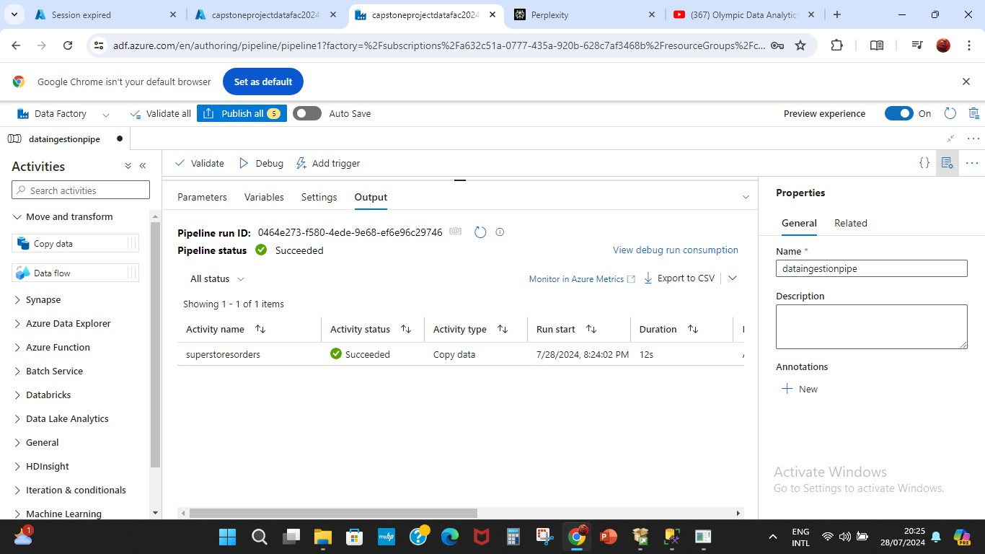
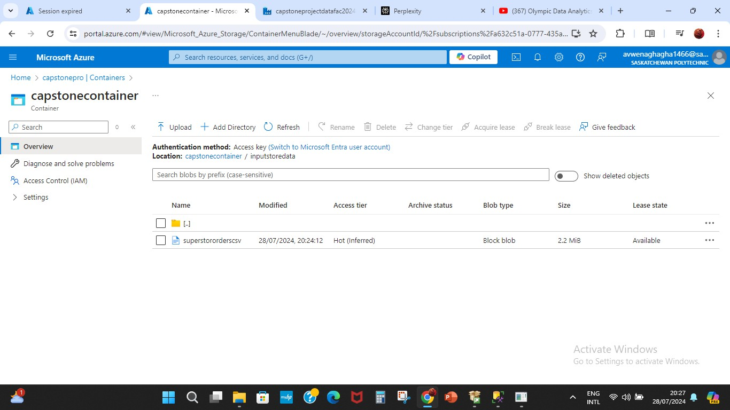
Pipeline successfully debugged and data transferred from SQL server to ADLS Gen 2 container created

Slide 16
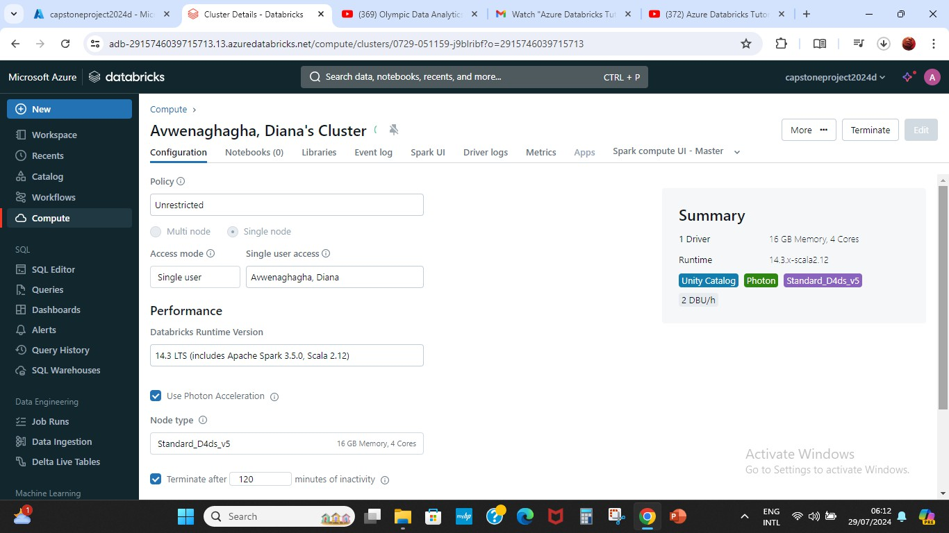
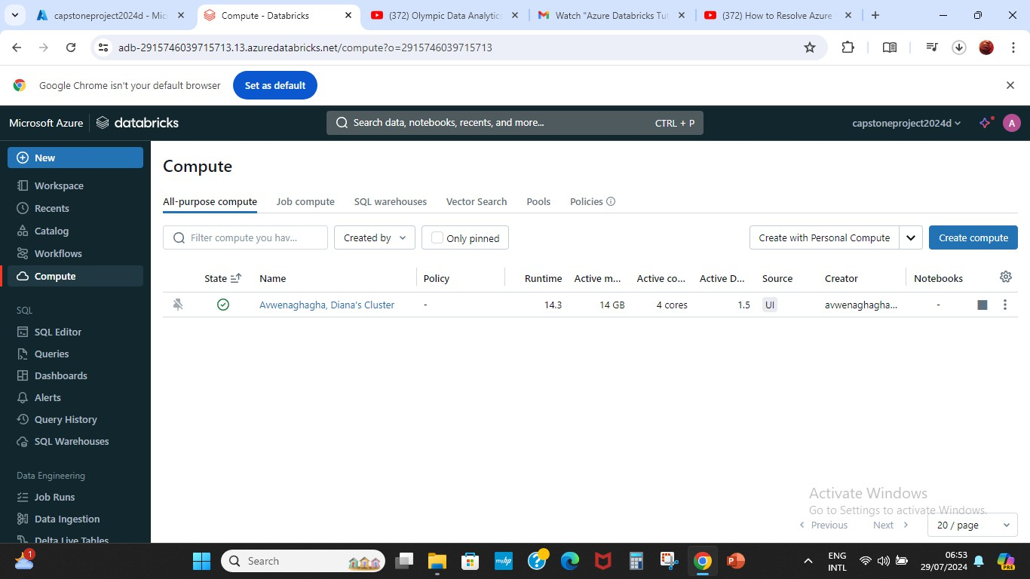
AZURE DATABRICKS
Azure Databricks is used to process and transform the raw data stored in Azure Data Lake Gen 2. It leverages Apache Spark for big data processing, allowing for complex transformations, aggregations, and data cleansing.
Databricks can enrich the data by joining it with other datasets, applying machine learning models, or performing advanced analytics.

Slide 17
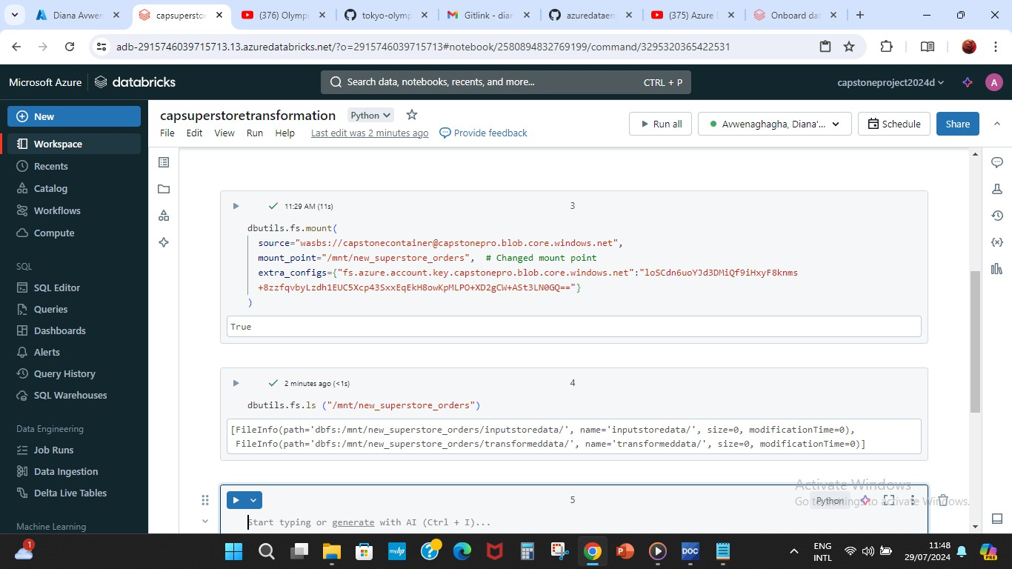
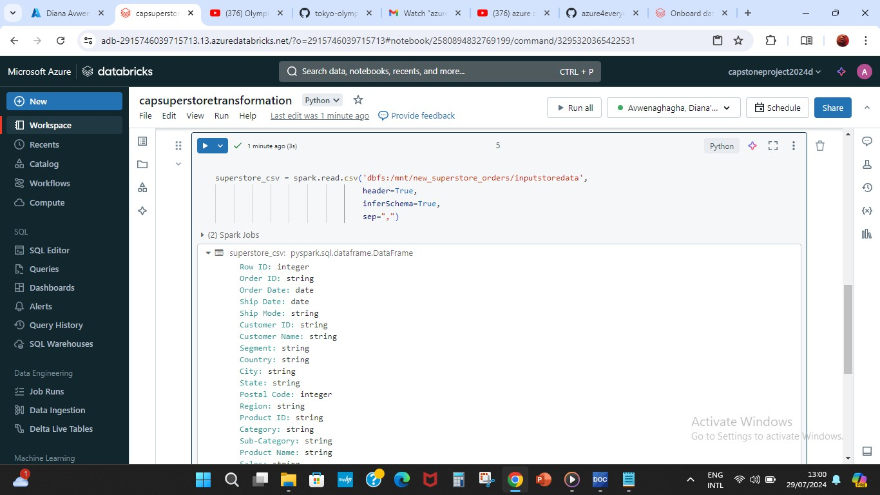
Cluster created used to run operations codes ran and connections to the blob storage successful
Notebook opened and connected to cluster created. Data frame created to work phyton.

Slide 18
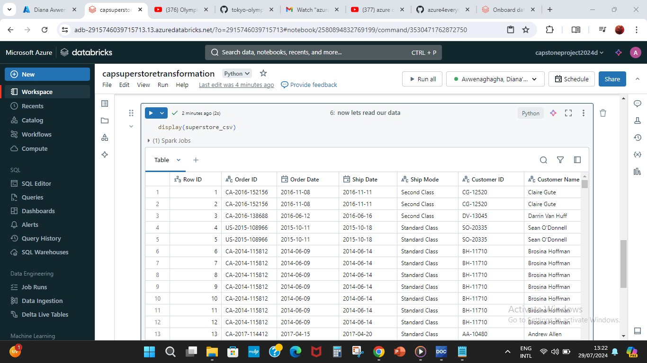
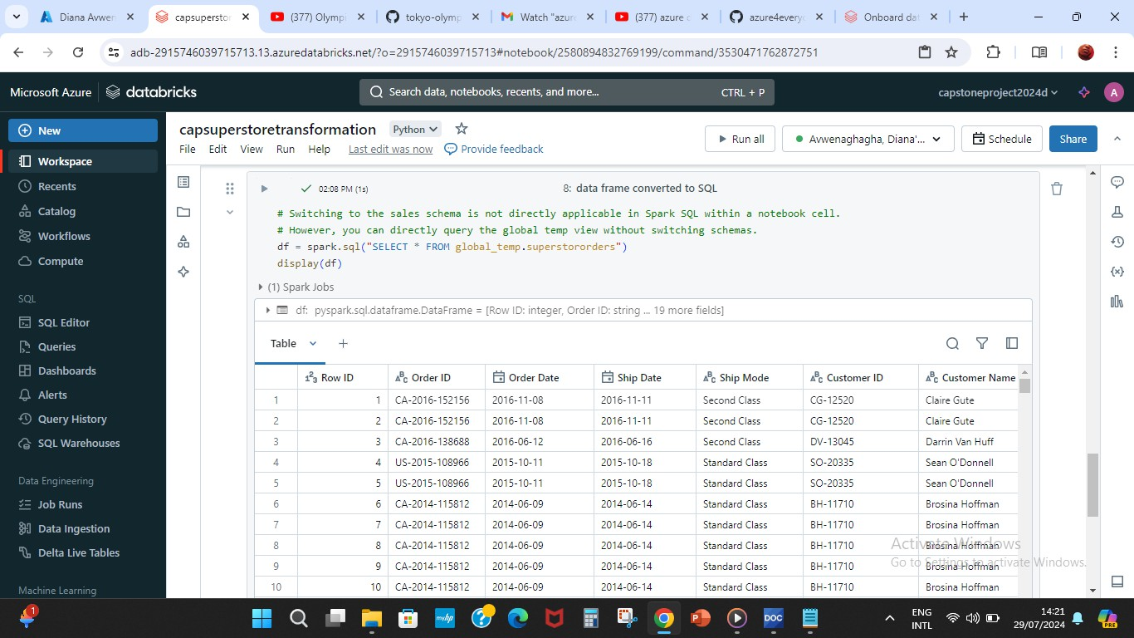
Raw data name replaced by new data frame name created and data viewed.
Creating tables in databricks using SQL commands.

Slide 19
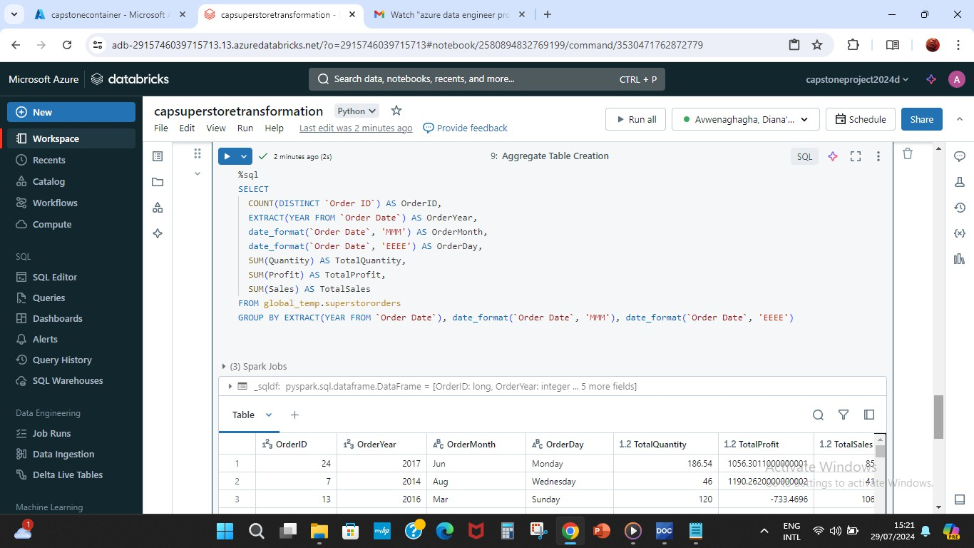
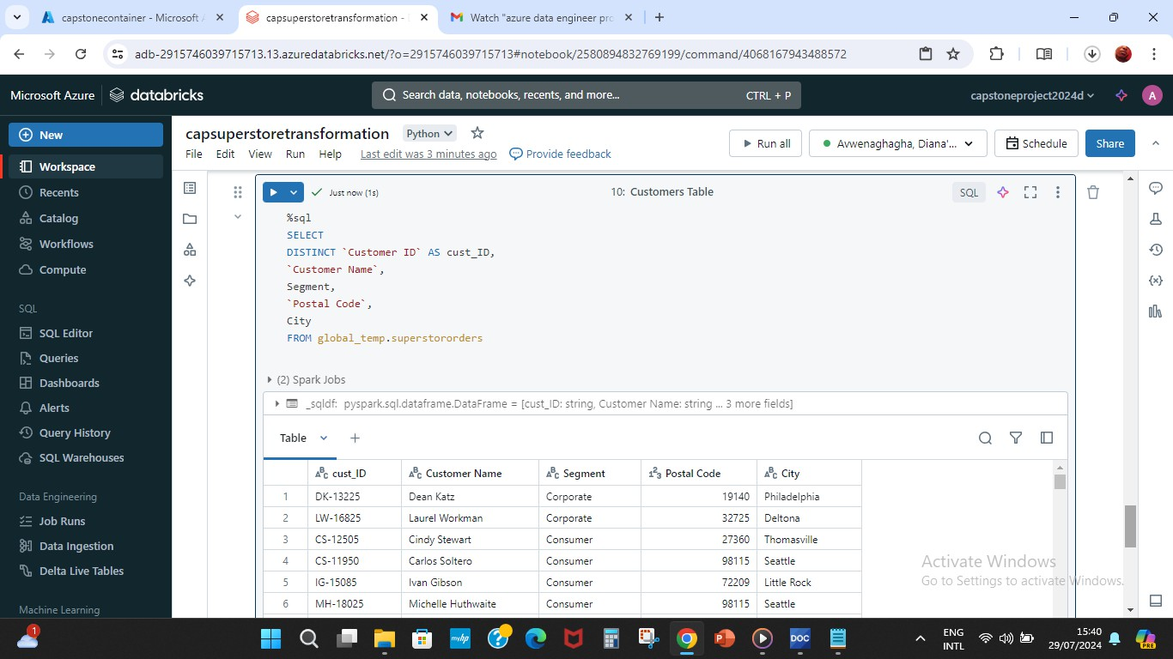
Aggregate table creation
Customers table creation

Slide 20
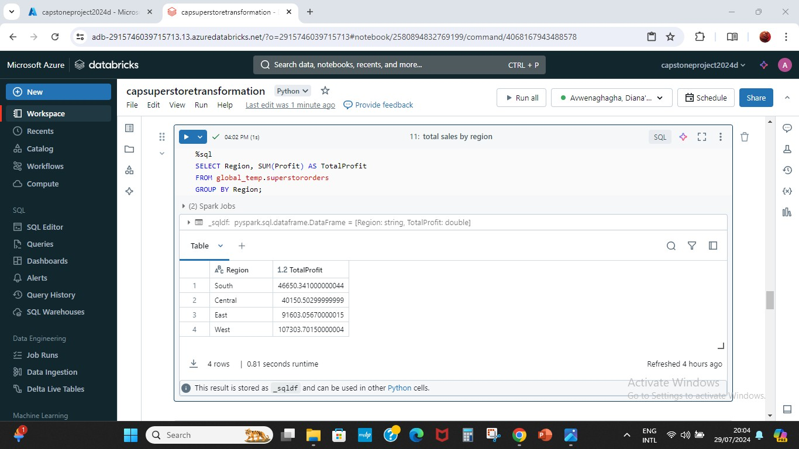
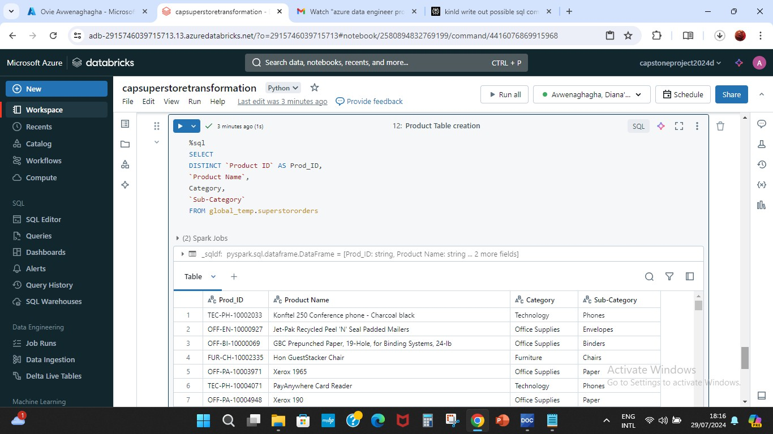
Total sales by region table created
Products table created

Slide 21
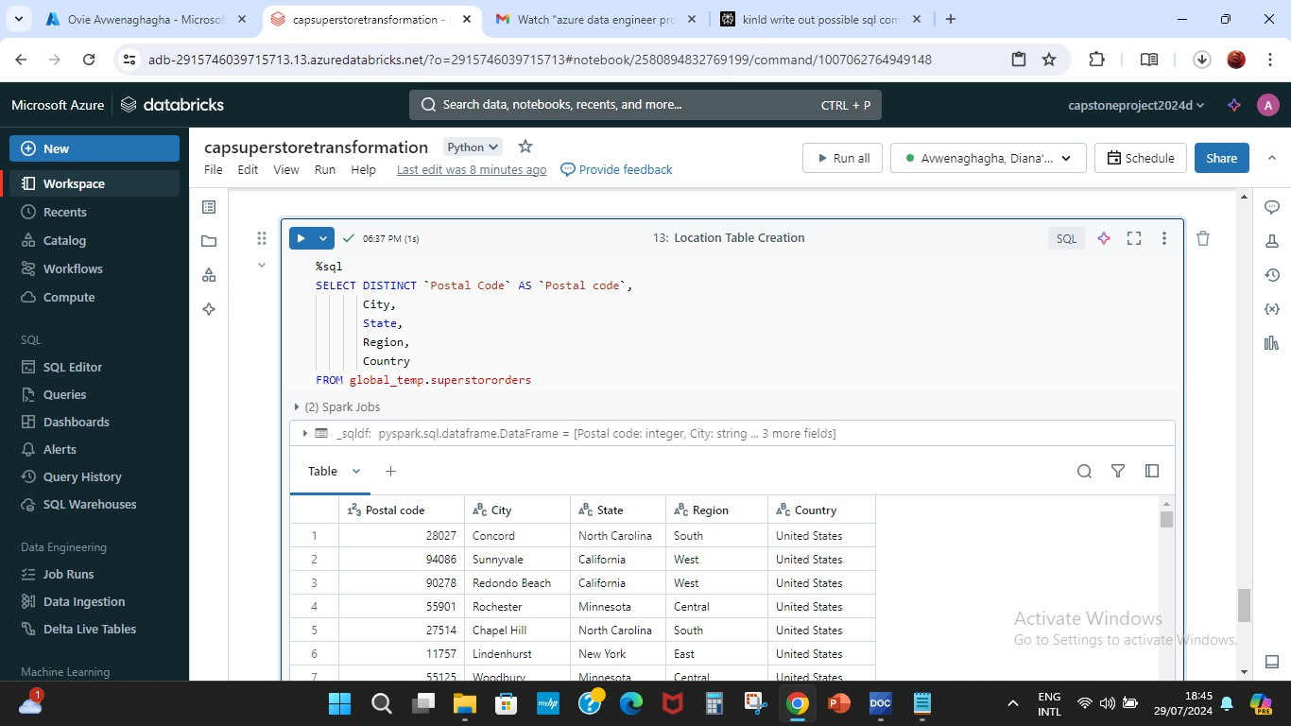
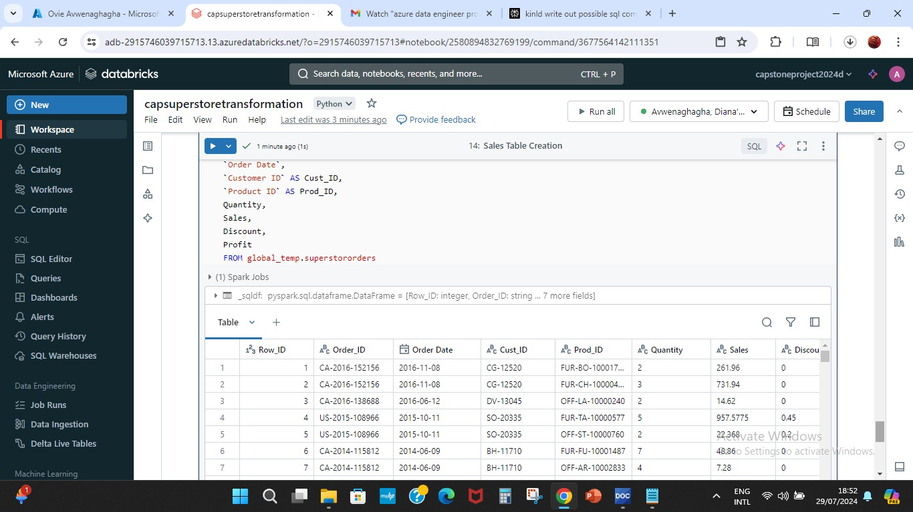
Location table created
Sales table created

Slide 22
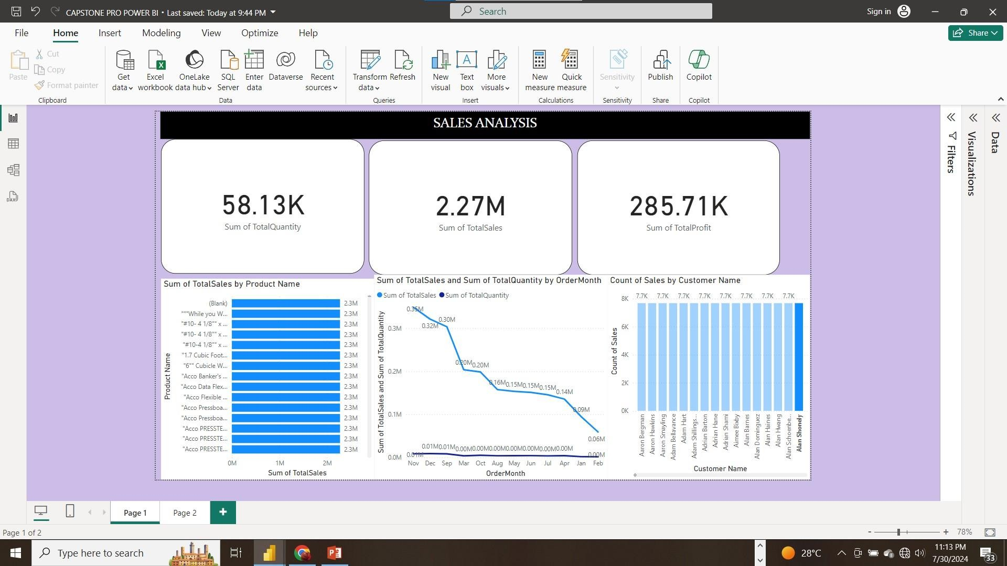
ANALYSIS & DASH-BOARDING

